Slide 1

Futurense
Democratizing Tech Talent to deliver impact at scale

Slide 2

Analysis of HealthCare Data
Made by :
Lokesh Kumar
FT613

Slide 3
Index :
Overview
Tools and Technologies used
Statistics
Data Cleaning and Visualization
Highlights
RDS and SQL connection
Procedures
Conclusion
Future Scope

Slide 4
Overview:
Processing the 2011 census data to find some relevant information about the healthcare department.
the values of some of data is missing ,that we have found by using data from other fields.
Analyse data after processing and filling the missing values on healthcare data.

Slide 5




Tools and Technologies Used:
Tool 1
Tool 2
Tool 3

Slide 6
Libraries/Packages/Features Used:
Pandas
Matplotlib
Pymysql / Sqlalchemy
RDS on AWS
GIT & GITHUB

Slide 7
Headline Statistics (1/2):
Average Execution Time – 10 min
Lines of Codes (LoC/KLoC) – 2.3 K
Total number of functions and procedures - 35
Number of built-in functions used - 20
Number of user-defined functions used - 5
Number of user-defined Procedures used - 10
Avg. number of lines per function - 4

Slide 8
Headline Statistics (2/2):
Number of comments written - 27
IDE/Code Editor Used - Jupyter Notebook
Function/Complexity breakdown:
Simple Implementations - 70%
Intermediate Implementations - 25%
Complex Implementations – 5%

Slide 9

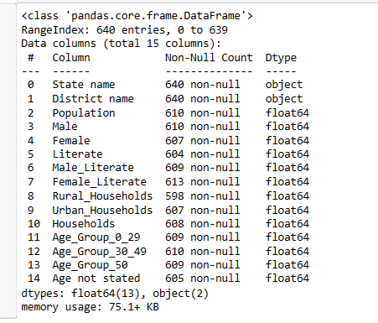
Step 1: Dump Unwanted Columns
we have left with a Dataframe that is only 15 columns down from 118 columns
Rename the Column names
New State/UT formation
Telangana formed in 2014
Laddakh formed in 2019

Slide 10
Step 2: Data Cleaning
Find and process the Missing Data for the columns
Population = Male + Female
Literate = Literate_Male + Literate_Female
Population = Young_and_Adult+ Middle_Aged + Senior_Citizen + Age_Not_Stated
Households = Households_Rural + Households_Urban

Slide 11
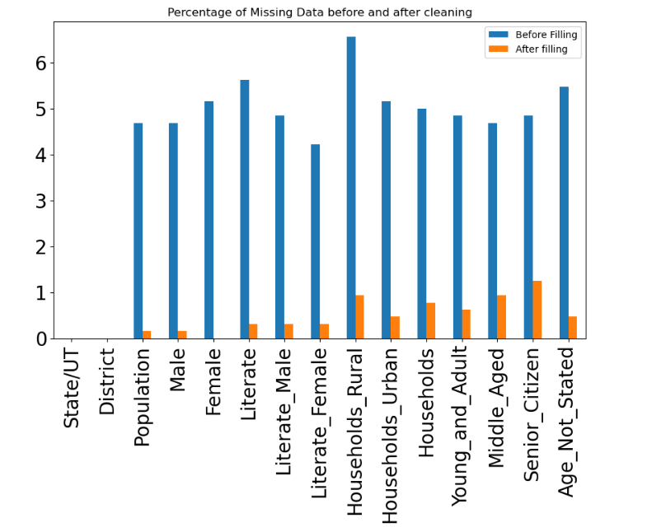
Ratio of Missing Data- before and after cleaning

Slide 12
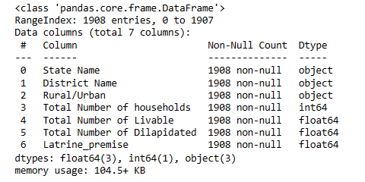
Step 3: Process the relevant data of Housing Dataset
Column Renaming
State/UT renaming
Updated State of Telangana and Laddakh

Slide 13
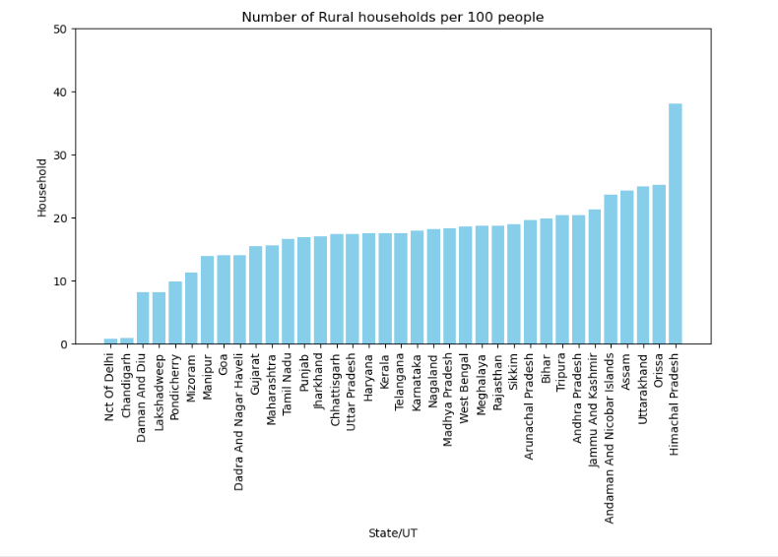
Step 4: Visualization based on cleaned data
Number of Rural households per 100 people
Himachal Pradesh having highest number of rural households per 100 people

Slide 14
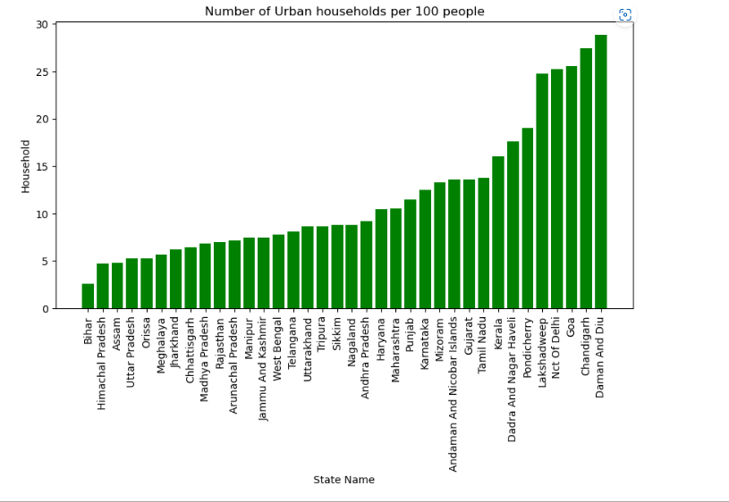
Step 4: Visualization based on cleaned data
Number of Urban households per 100 people
Daman and Diu having highest number of urban households per 100 people

Slide 15
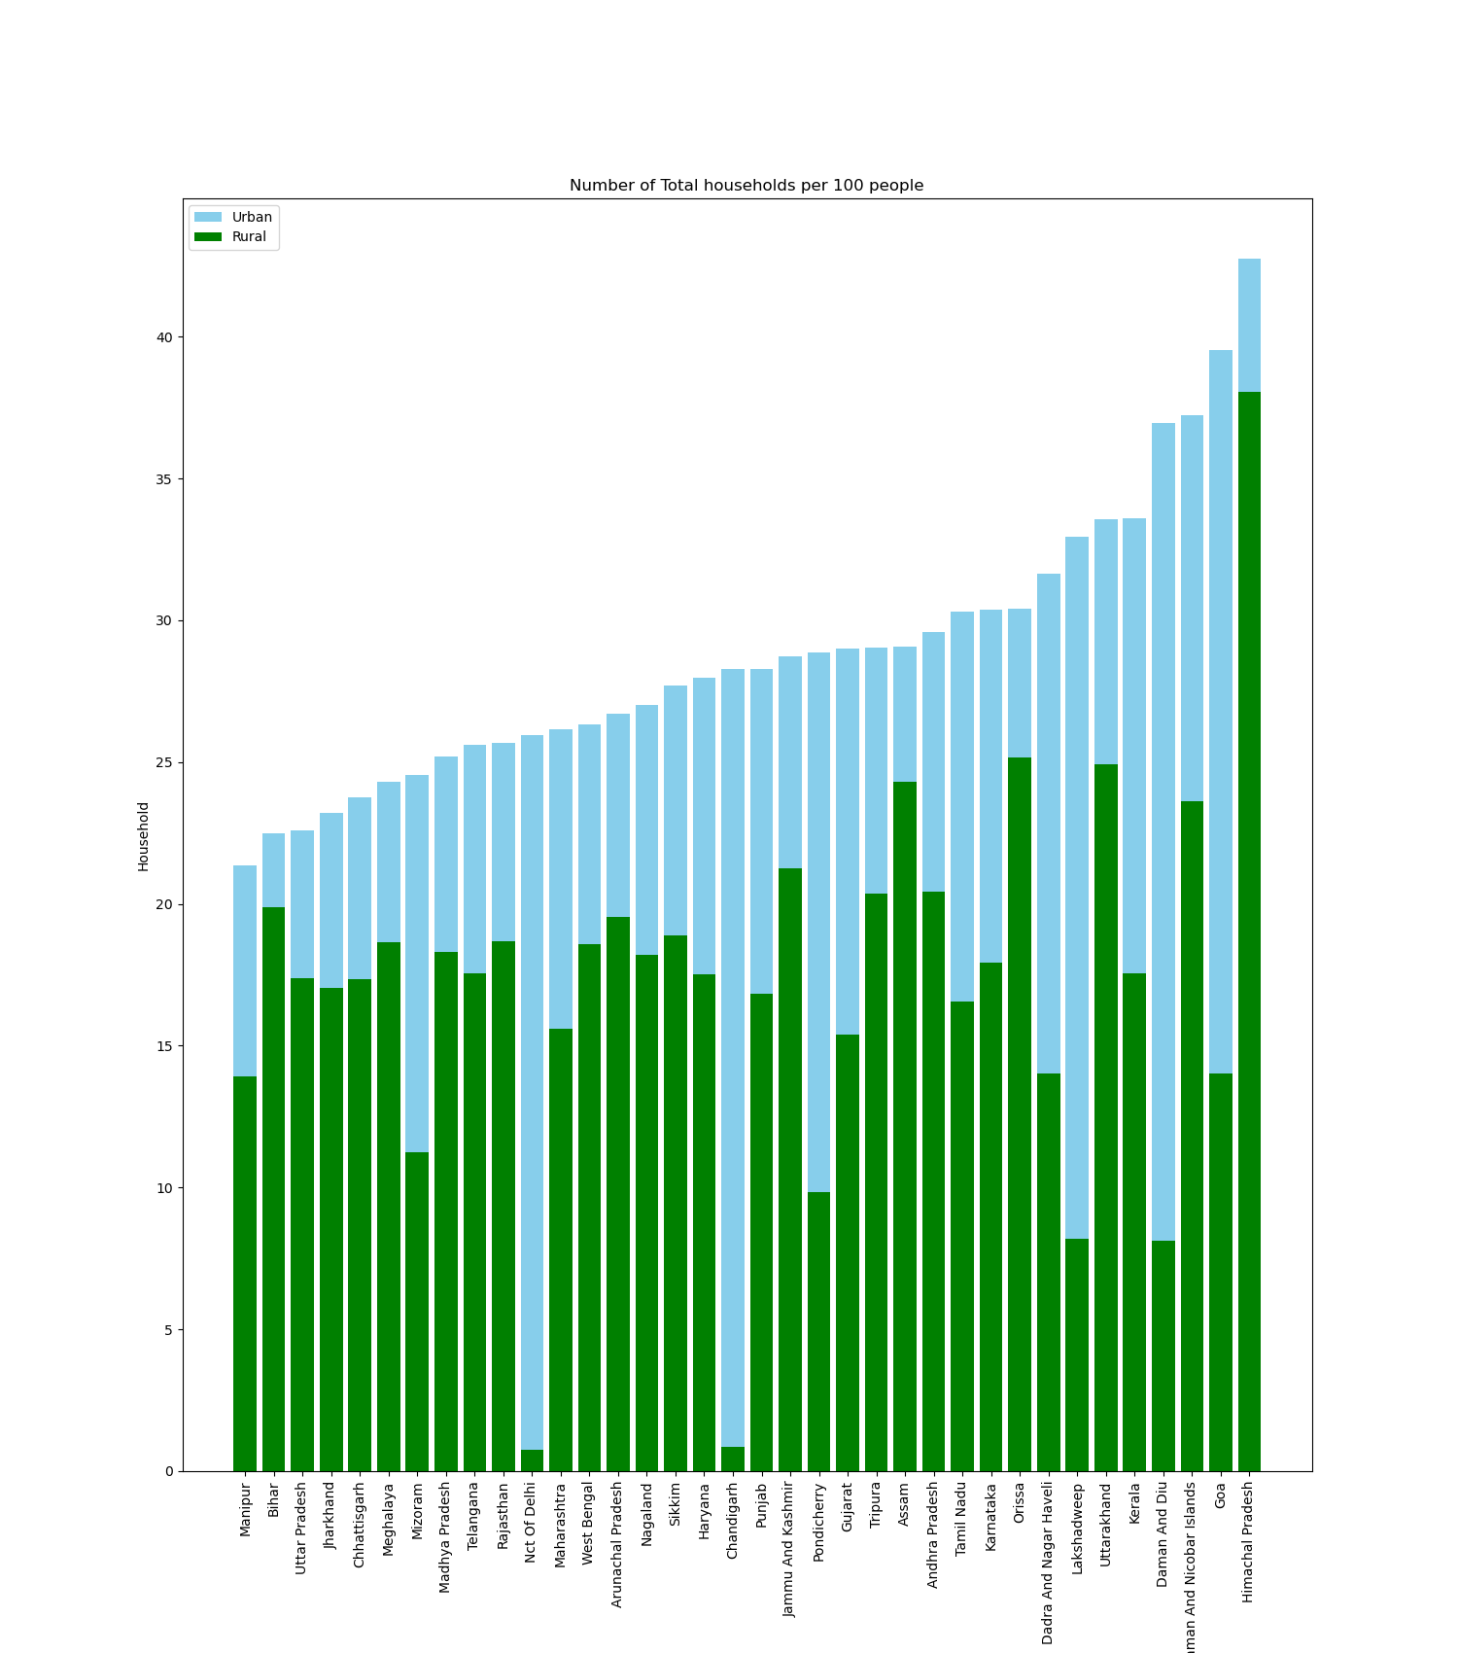
Step 4: Visualization based on cleaned data
Number of households per 100 people
Himachal having total highest households

Slide 16
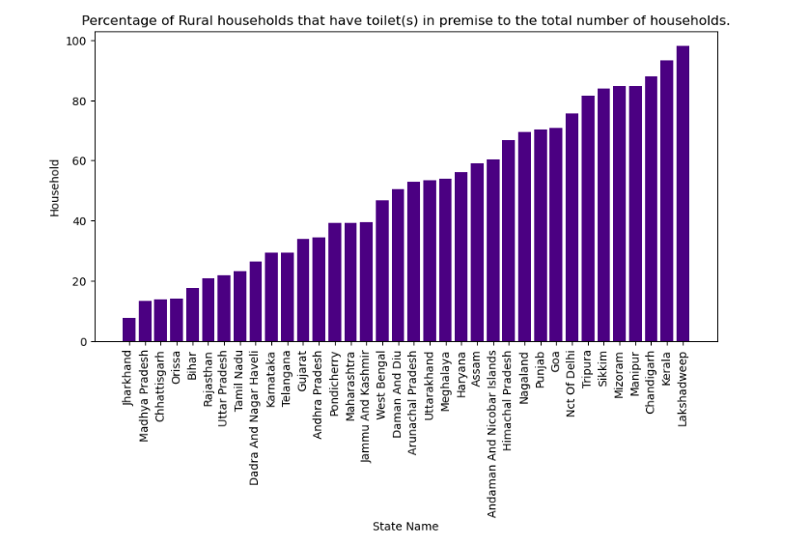
Step 4: Visualization based on cleaned data
Percentage of Rural households that have toilet(s) in premise to the total number of households
Lakshadweep Rural is on top for providing sanitation facility

Slide 17
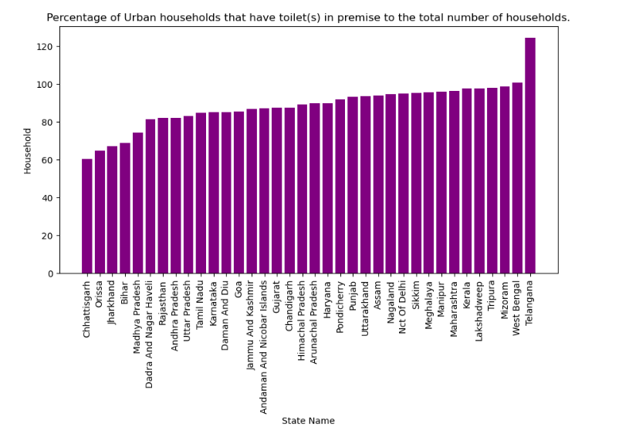
Step 4: Visualization based on cleaned data
Percentage of Urban households that have toilet(s) in premise to the total number of households
In urban states providing proper sanitations are:
Kerala
Lakshadweep
Tripura
Mizoram
West Bengal
Telangana

Slide 18
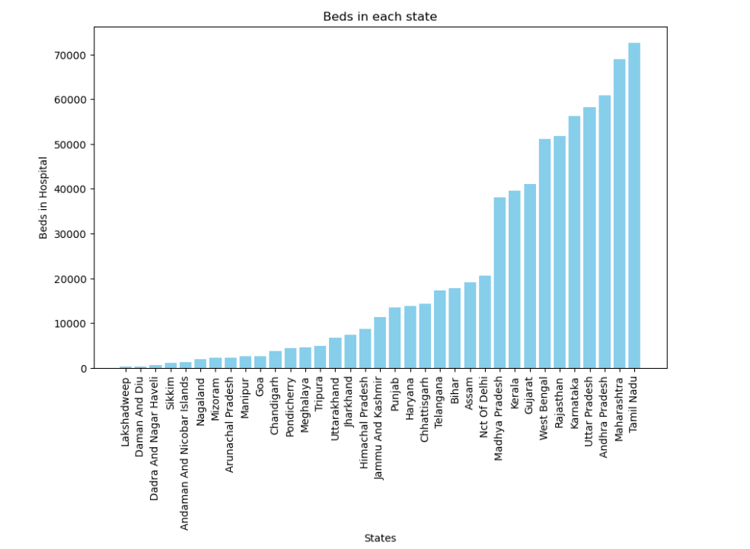
Step 4: Visualization based on cleaned data
Beds Available in each state

Slide 19
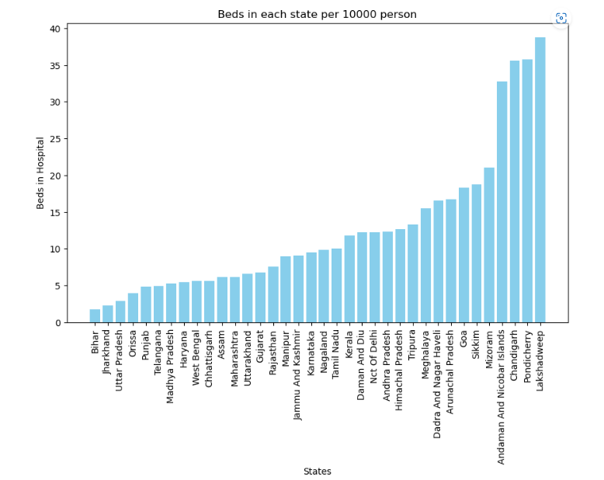
Step 4: Visualization based on cleaned data
Beds Available in each state per 10000 person
Minimum beds available in :
Bihar
Jharkhand
Uttar Pradesh

Slide 20
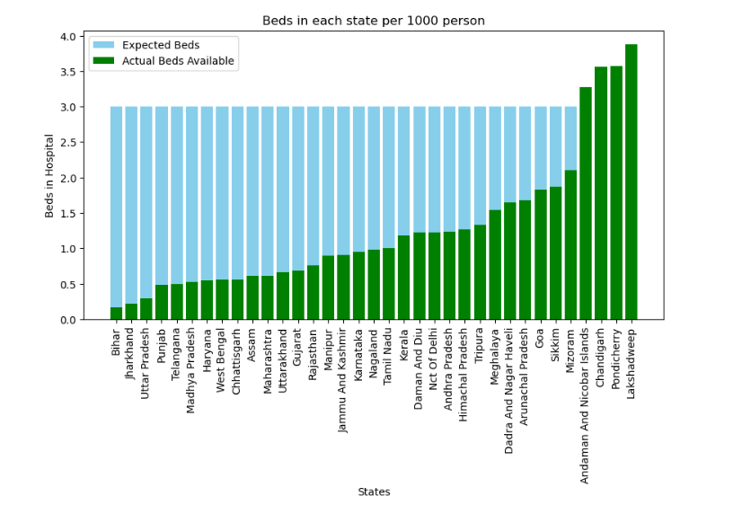
Step 4: Visualization based on cleaned data
Beds in each state per 1000 person vs WHO standard guidelines
State/UT satisfying WHO guidelines:
Lakshadweep
Pondicherry
Chandigarh
Andaman and Nicobar

Slide 21
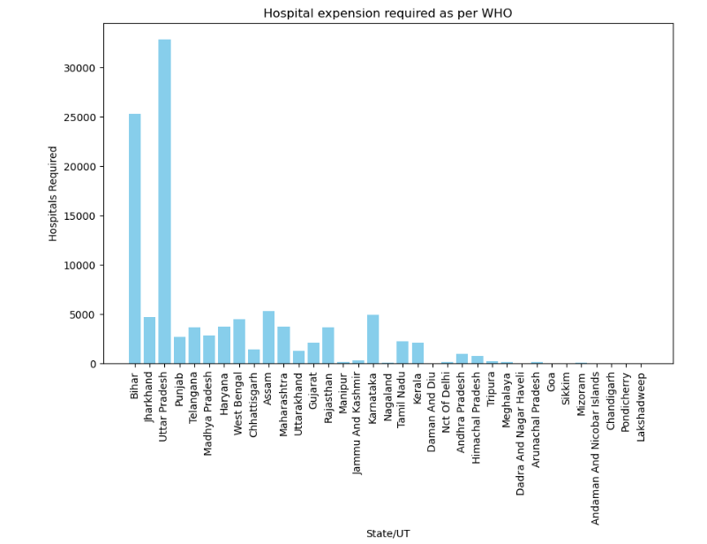
Step 4: Visualization based on cleaned data
Maximum Hospital expansion required as per WHO guidelines in :
Bihar
Uttar Pradesh

Slide 22
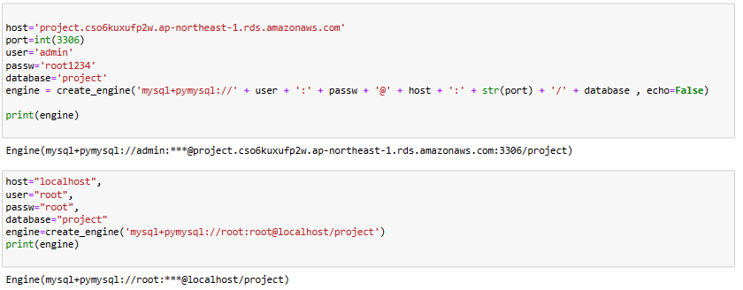
SQL Connection
RDS connection
Localhost connection

Slide 23
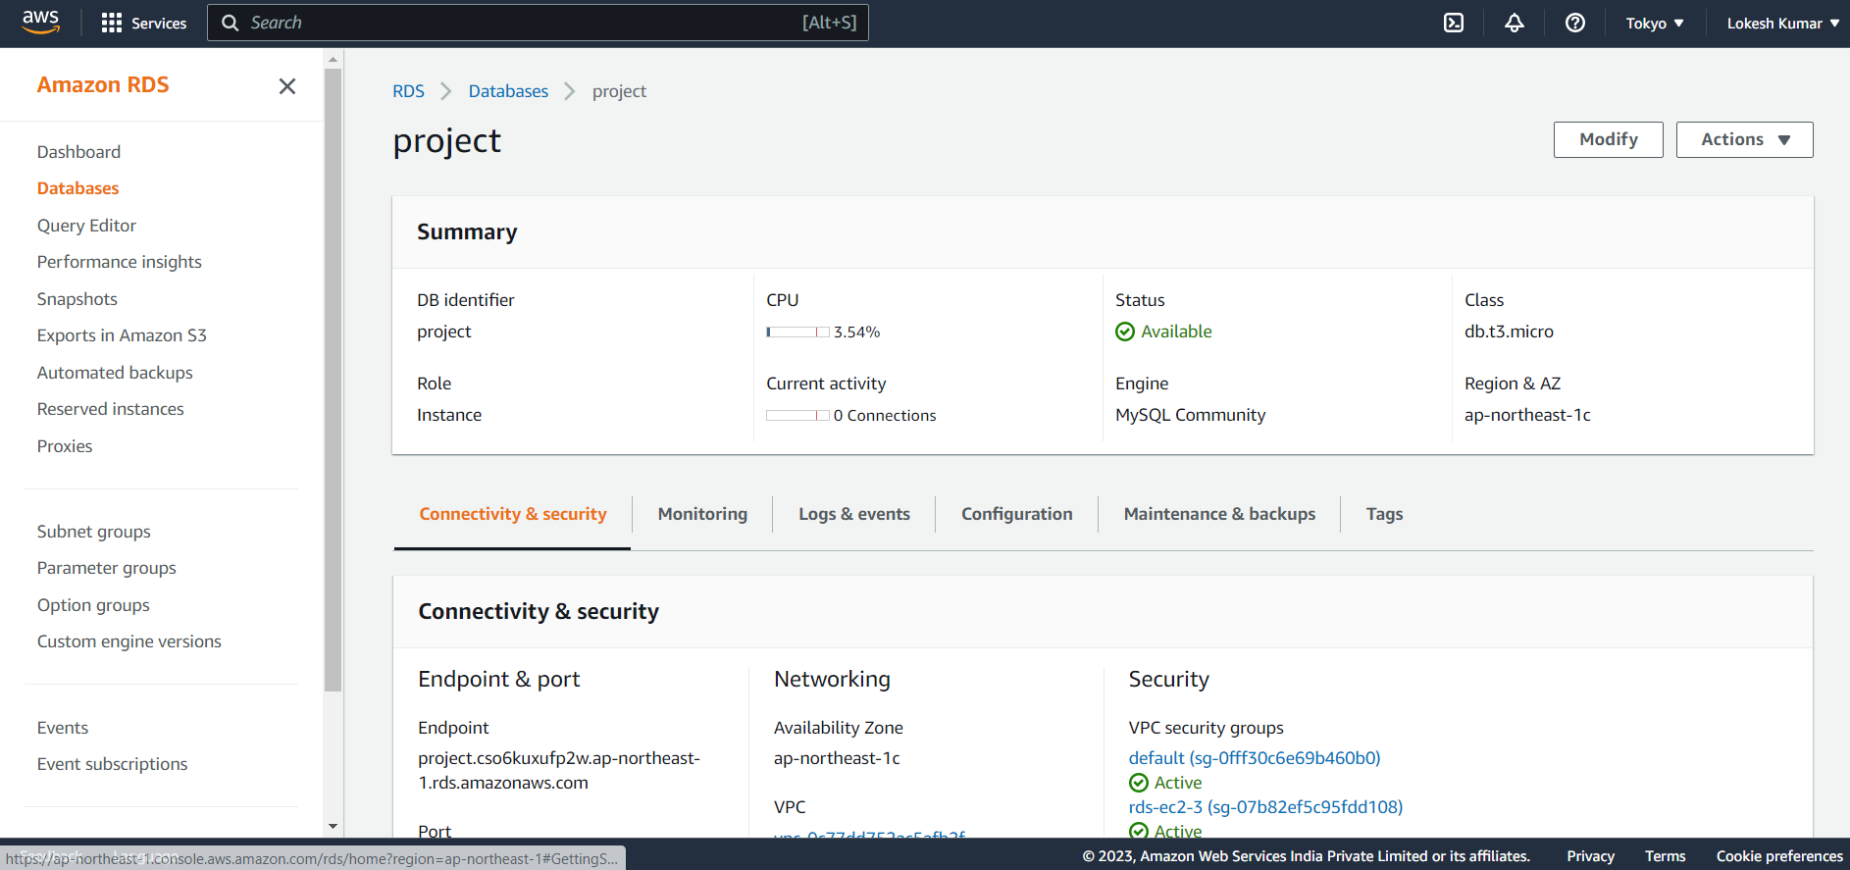
RDS connection
Created RDS with database and provided access to all inbound traffic

Slide 24
SQL Connection
RDS connection
Localhost connection

Slide 25
SELECT h.`State/UT`,h.District,
(h.Households_Rural+h.Households_Urban - (h.Households_Rural_Toilet_Premise + h.Households_Urban_Toilet_Premise)) as Household_without_toilet_inpremises ,
(h.Population*0.003 - (a.HospitalBeds*1000 / h.Population)) as gap_of_beds FROM housing h
join all_hospitals a
on h.`State/UT`=a.`State/UT`
where (h.Population*0.003 - (a.HospitalBeds*1000 / h.Population))>0 and
((h.Households_Rural+h.Households_Urban) - (h.Households_Rural_Toilet_Premise + h.Households_Urban_Toilet_Premise))>0
order by gap_of_beds ;
To finds the number of households without a toilet on the premise for each district of the state that has the least hospital bed-to-population ratio.

Slide 26
CREATE PROCEDURE get_population_district (in dis varchar(48))
BEGIN
SELECT District, Population FROM census c where c.District = dis ;
END ;
CREATE PROCEDURE get_population (in state varchar(48))
BEGIN
SELECT `State/UT` , District, Population FROM census c where c.`State/UT` = state ;
END ;
CREATE PROCEDURE senior_citizen_population (in state varchar(40))
BEGIN
SELECT `State/UT`, sum(Senior_Citizen) as Total_Senior_citizen FROM census c where c.`State/UT` = state group by `State/UT`;
END ;
CREATE PROCEDURE if not exists get_hospital_beds (in state varchar(40))
BEGIN
SELECT `State/UT`, HospitalBeds FROM all_hospitals a where a.`State/UT` = state ;
END ;
Stored Procedure to find details related to specific state or district
CREATE PROCEDURE get_govt_hospital_beds (in state varchar(40))
BEGIN
SELECT `State/UT`, Rural_Government_Beds+ Urban_Government_Beds as Total_beds FROM government_hospital g where g.`State/UT` = state ; END ;

Slide 27
Conclusion
State with less hospitals – Bihar , Jharkhand , Uttar Pradesh
States with minimum households – Manipur
States falling behind in sanitation facility - chhattisgarh , orissa , jharkhand , Bihar , Madhya Pradesh
States following WHO guidelines – Lakshadweep , Pondicherry , Chandigarh , Andaman and Nicobar

Slide 28
For Optimisation
Functions and procedures for repetitive task
Inplace operation to reduce memory consumption
builtin function

Slide 29
Future Scope
BI tools can be implemented for better visualization

Slide 30
Thank You

